Slide 1


FIT9136 PASS WEEK 3
Introduction to conditionals, iteration and sequences
5th Aug 2024
CL_33 Innovation Walk, Room C107

Slide 2

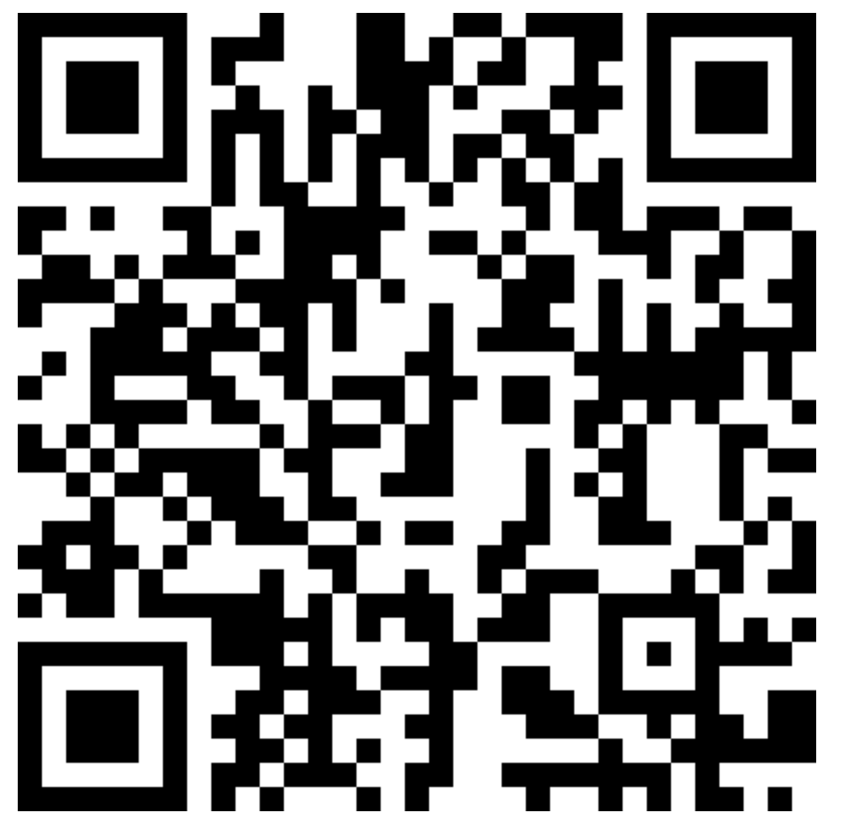
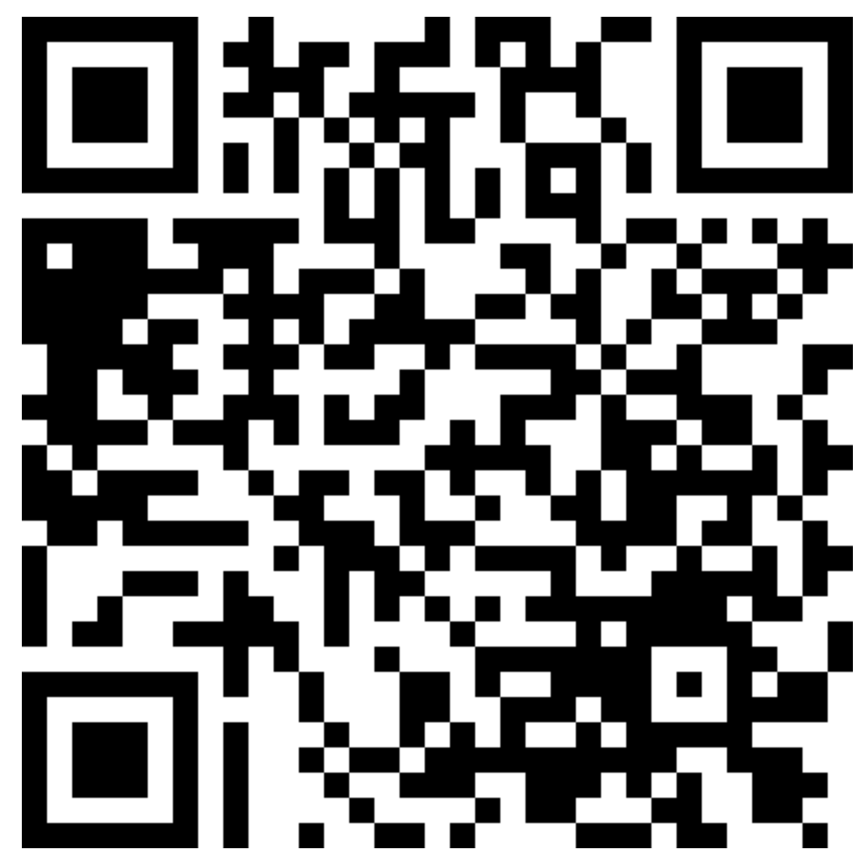
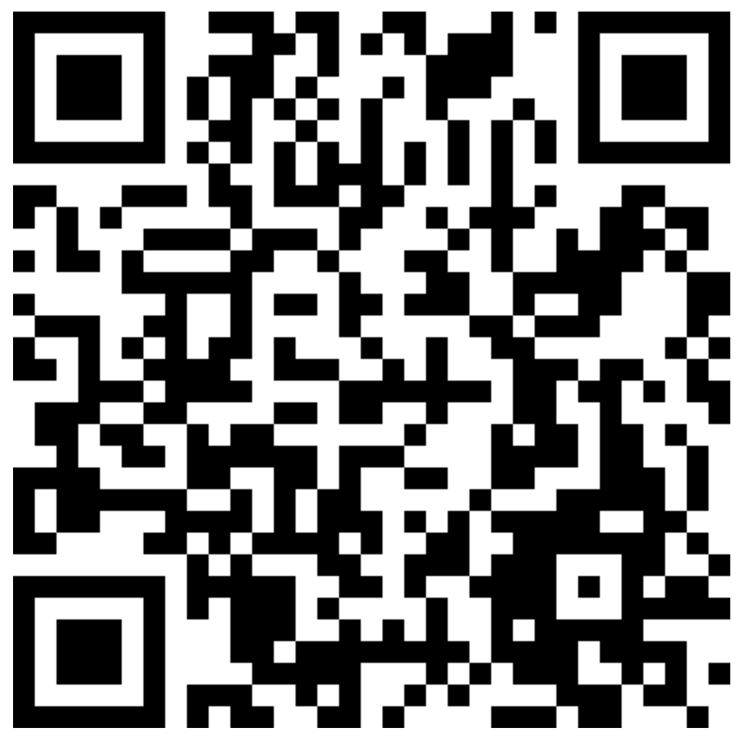

Attendance & Resources
Attending sessions is not mandatory but highly recommended.
Attendance is not assessed.
Any questions? Email me: harry.wang1@monash.edu
Also find the drive to receive the weekly slides: https://tinyurl.com/FIT9136-PASS
Monday 2-3pm
Tuesday 9-10am
Tuesday 4-5pm

Slide 3
Agenda
01
Materials Recap Activities - 25 mins
Materials are reviewed by doing practice.
02
Problem Solving Session - 20 mins
More challenging problem which needs you to combine all your learning. Thinking > Coding
03
Closure speaking - 10 mins
Attendance recording

Slide 4
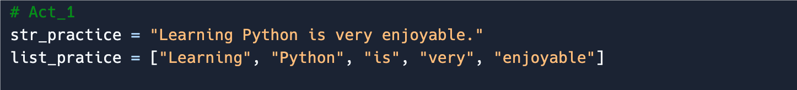
Revision Activity 1 - string & list
Find the base code: https://tinyurl.com/wk3-coding
Tasks:
Print them out, and see what is the difference
Print out the phrase “Learning Python” based on both string and list
Print out the phrase “Python is very enjoyable” based on the string
Print out the phrase “PythonPythonPython” based on both the string and list

Slide 5
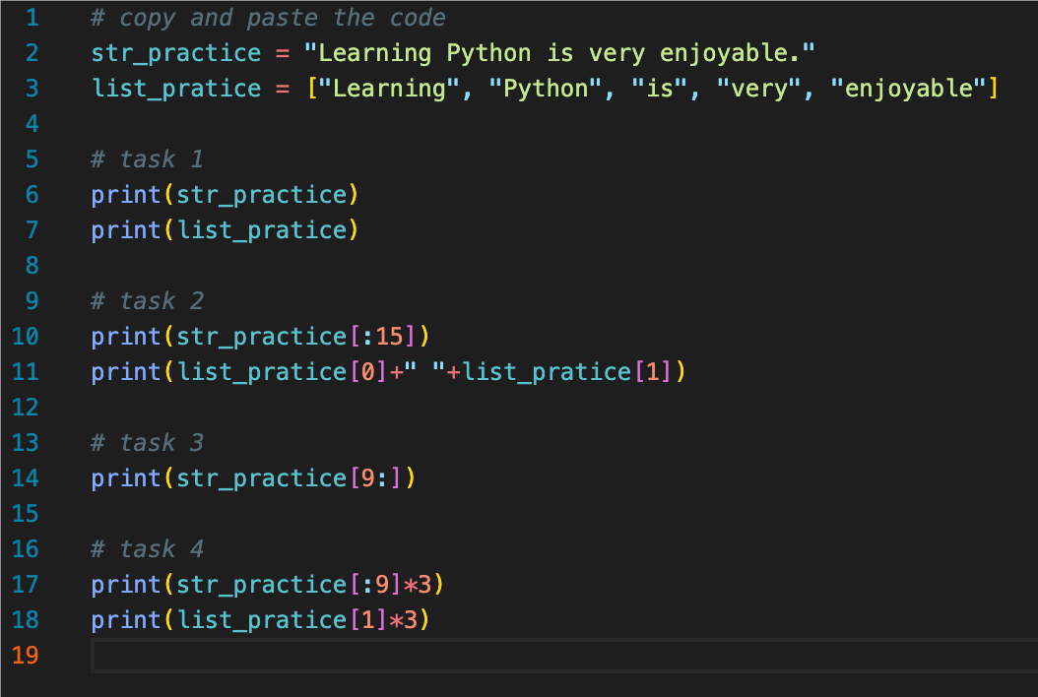
Revision Activity 1 - Solution
list, string
Index
Slice Operator
Concatenation and Repetition

Slide 6
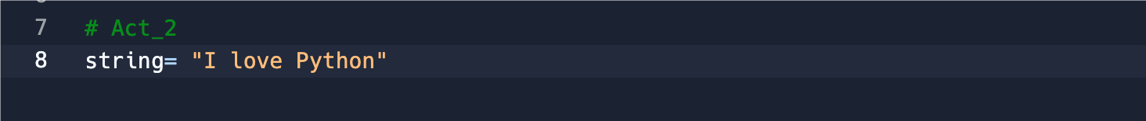
Revision Activity 2 - for & while
Find the base code: https://tinyurl.com/wk3-coding
Tasks:
Output the string in the positive direction
Output the string in the reverse direction
（Each letter does not have to be on the same line）

Slide 7
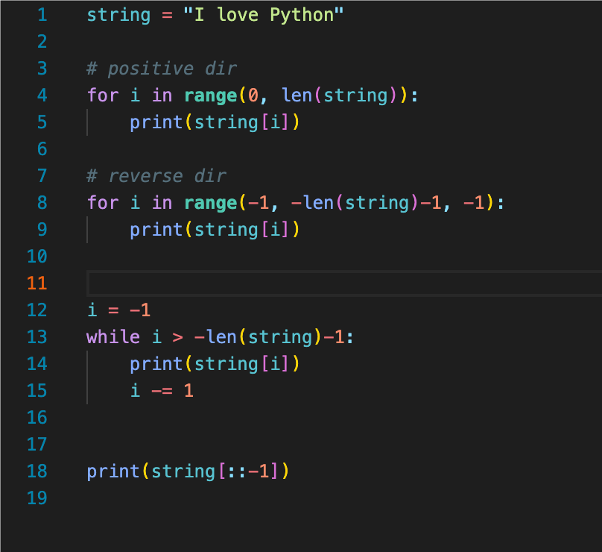
Revision Activity 2 - Solution

Slide 8
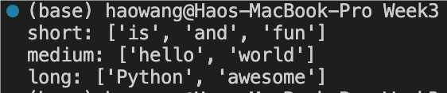
Revision Activity 3 - if & else
Find the base code: https://tinyurl.com/wk3-coding
Tasks:
Iterate over each word in the list.
Classify each word based on its length:
If the word length is less than 5, classify it as “short”.
If the word length is exactly 5, classify it as “medium”.
If the word length is greater than 5, classify it as “long”.
Print out all categorised words

Slide 9
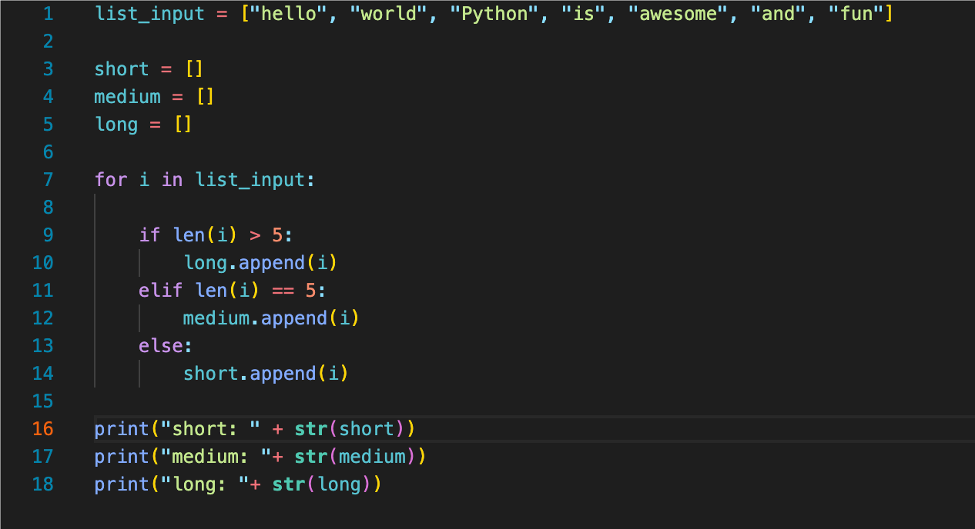
Revision Activity 3 - Solution

Slide 10
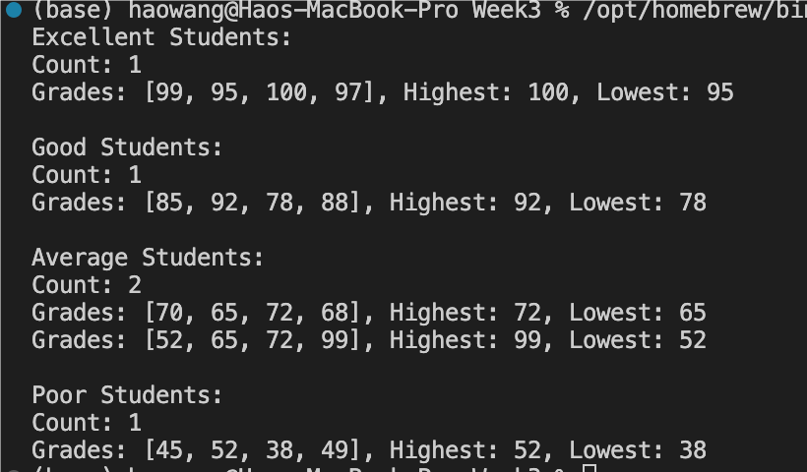
Problem Solving Session
Problem Statement:
You are a teacher who needs to analyze the grades of your students. Each student’s grades for different subjects are represented as a list of integers in a two-dimensional list. Each row in the two-dimensional list represents a student, and each column represents a subject grade. Your task is to perform the following operations:
1. Identify Top and Bottom Performers: For each student, identify the highest and lowest grades.
2. Classify Students: Classify each student based on their average grade:
• If the average grade is 90 or above, classify as “Excellent”.
• If the average grade is between 75 and 89, classify as “Good”.
• If the average grade is between 50 and 74, classify as “Average”.
• If the average grade is below 50, classify as “Poor”.
3. Generate Summary: Create a summary that includes:
• The total number of students in each category (“Excellent”, “Good”, “Average”, “Poor”).
• A list of students in each category with their highest and lowest grades.
Student Data: https://tinyurl.com/wk3-coding

Slide 11
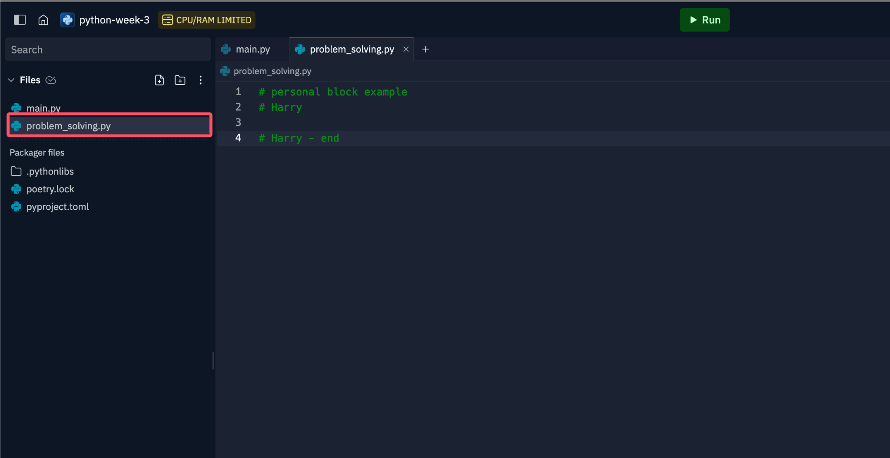
Code Collection
Please store your code into this file:

Slide 12
Thank You
5th Aug 2024
CL_33 Innovation Walk, Room C107

Slide 13
Questions & Answers
5th Aug 2024
CL_33 Innovation Walk, Room C107

